Slide 1


NEXT HIKES IT SOLUTION
Calculator GUI
A multi-functional scientific & converter calculator — built with Python and Tkinter
PROJECT-2
MONALISHA DAS

Slide 2

Project Objective
Build an all-in-one calculator with a modern UI, multiple utilities, and real-time computation — all in a single desktop app.
Modern UI
Multi-Utility
Hover effects & clean layout
Science + conversions
Real-Time
Instant computation

Slide 3
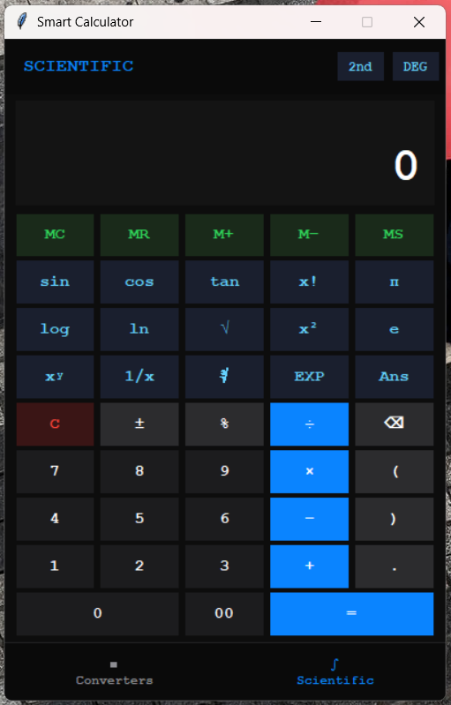


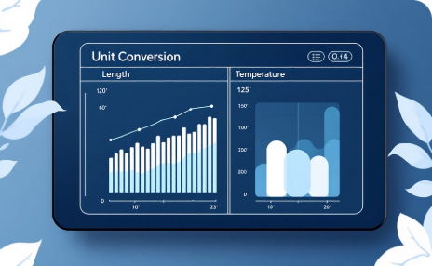

Key Features
Scientific Calculator
Page Navigation
Trig, log, memory & real-time evaluation
Seamless page switching via controller
Unit Converters
Modern UI
Length, mass, temp, speed & more
Hover effects & polished design

Slide 4
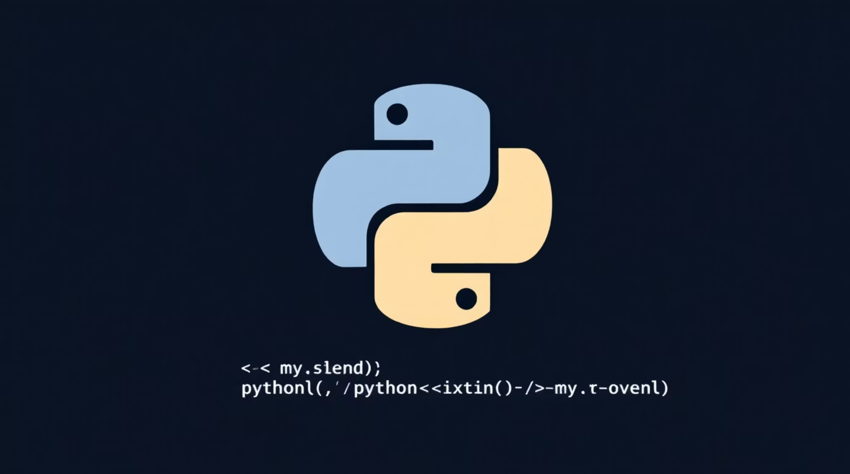
Libraries Used
Python
Core language
Tkinter
GUI framework
Math Library
Scientific functions
Datetime Library
Time-based conversions

Slide 5

Scientific Calculator
Trigonometry
Logarithms
sin, cos, tan & inverses
log, ln & exponentials
Memory Ops
Live Evaluation
M+, M−, MR, MC
Results update instantly

Slide 6





Converters Included
Length & Mass
Temperature
Speed & Time
Meters, feet, kg, lbs and more
Celsius, Fahrenheit, Kelvin
km/h, mph, seconds to hours
Date & Numerals
Volume
Binary, hex, octal
Liters, gallons, milliliters

Slide 7

Challenges Faced
1
Operator Overwrite
Consecutive operators corrupted expression
2
Page Navigation Errors
Frame switching caused state loss
3
UI Alignment
Inconsistent grid spacing
4
Input Validation
Invalid expressions crashed evaluation

Slide 8

Solutions Implemented
Operator Replacement
Error Handling
Modular Pages
Centered Grid UI
References: https://stackoverflow.com/questions/70799509/python-and-visual-studio-code-pylancereportundefinedvariable

Slide 9



